Slide 1
CIS 11 – Computer Architecture
James Wilson

Slide 2
Basic Concepts
Digital Logic
On/Off
Binary Language
Binary numbers
Letters
Language
Instructions
Machine Language

Slide 3
Assembly Language
Abstraction of Machine Language
Human readable
Mnemonics
ADD
MOV
SUB
CALL
One-to-one relationship with machine language

Slide 4
High-Level Languages (3G)
Abstraction of Assembly Language
Human readable
Typically what is used today
Java
C++
.NET (MSIL)
JavaScript / Typescript
One-to-many relationship with assembly language
Example on page 4

Slide 5
Language Progression
1G - Machine
Binary
Efficient
2G - Assembly
Mnemonics
3G – HL Languages
Java
Somewhat readable
MSIL
Not readable

Slide 6
Abstraction Layers
int Y;
int X = (Y + 4) * 3;
mov eax, Y
add eax, 4
mov ebx, 3
imul ebx
mov X, eax
00000011 10001110 00000110
00000010 11100001 00000011
00000001 10001110 00000001
00000010 11100001 00011100
00000111 10001110 00000100

Slide 7
Portability
“A language whose source programs can be compiled and run on a wide variety of computer systems is said to be portable.”
Benefits?
Drawbacks?
Assembly language is not portable

Slide 8
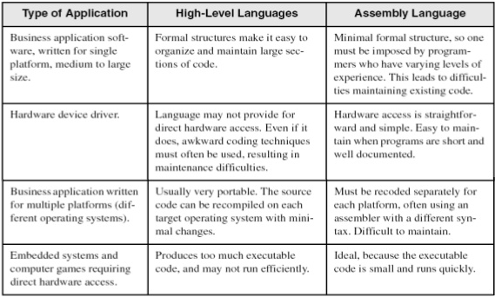
Applications

Slide 9
Binary & Hexadecimal
Exercises
What would a trinary language look like? Unary?
Suppose there are 256 shades of red, green, and blue. Suppose all colors can be made up of different shades of red, green, and blue.
How many combinations are there?
How many hexadecimal characters do you need to represent them all?
How might you represent them?

Slide 10
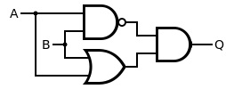
Binary Arithmetic
Addition
Example on page 12
Subtraction
Also addition
Two’s compliment
What type of gate could we use for this?
Signed versus Unsigned
Addition
Example on page 12
Subtraction
Also addition
Two’s compliment
What type of gate could we use for this?
Signed versus Unsigned

Slide 11
Hexadecimal Arithmetic
Addition
Example on page 16
Subtraction
Also addition
Two’s compliment
Signed versus Unsigned

